Slide 1
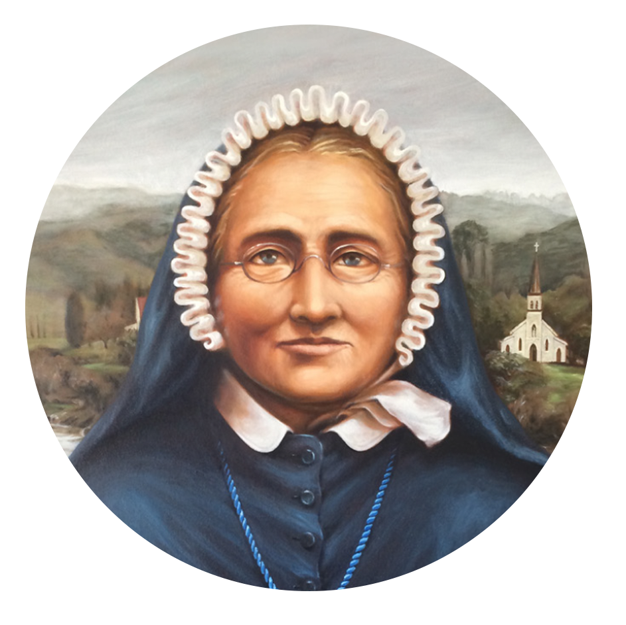
Prayer of the faithful
Te Reo
E te Atua o te Pūaroha
I a mātou e whakakotahi nei me te whakamoemiti ki te atua, ka whakawhetai mātou mō te wā i a tō mātou Kahurangi a Meri Hōhepa.
Ka inoi mātou kia ora tonu tōna whakapono, tōna maia, tōna pūaroha anō hoki ki roto i tēnā i tēnā o mātou...
E te Ariki: Whakarongo mai rā ki a mātou

