Slide 1
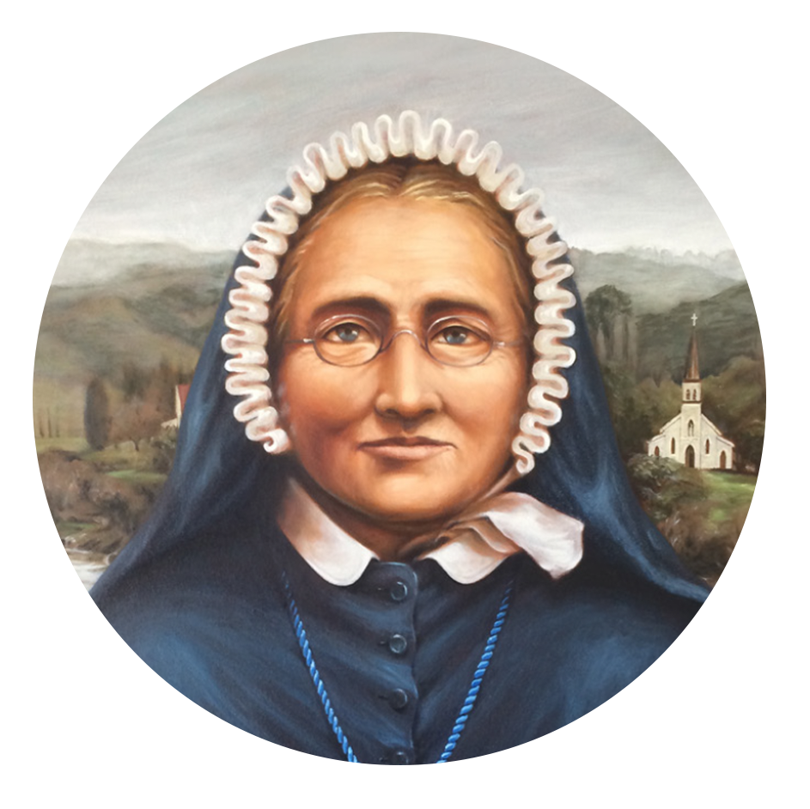
Prayer of the faithful
E te Atua o te Pūaroha - God of Compassion
As we unite in prayer across Aotearoa New Zealand on this Celebration Day, we pray in thanksgiving for the life of Venerable Meri Hōhepa Suzanne Aubert. We pray that her faith, her courage, and compassionate love will live on in us all.
E te Ariki: Whakarongo mai rā ki a mātou

