Slide 1
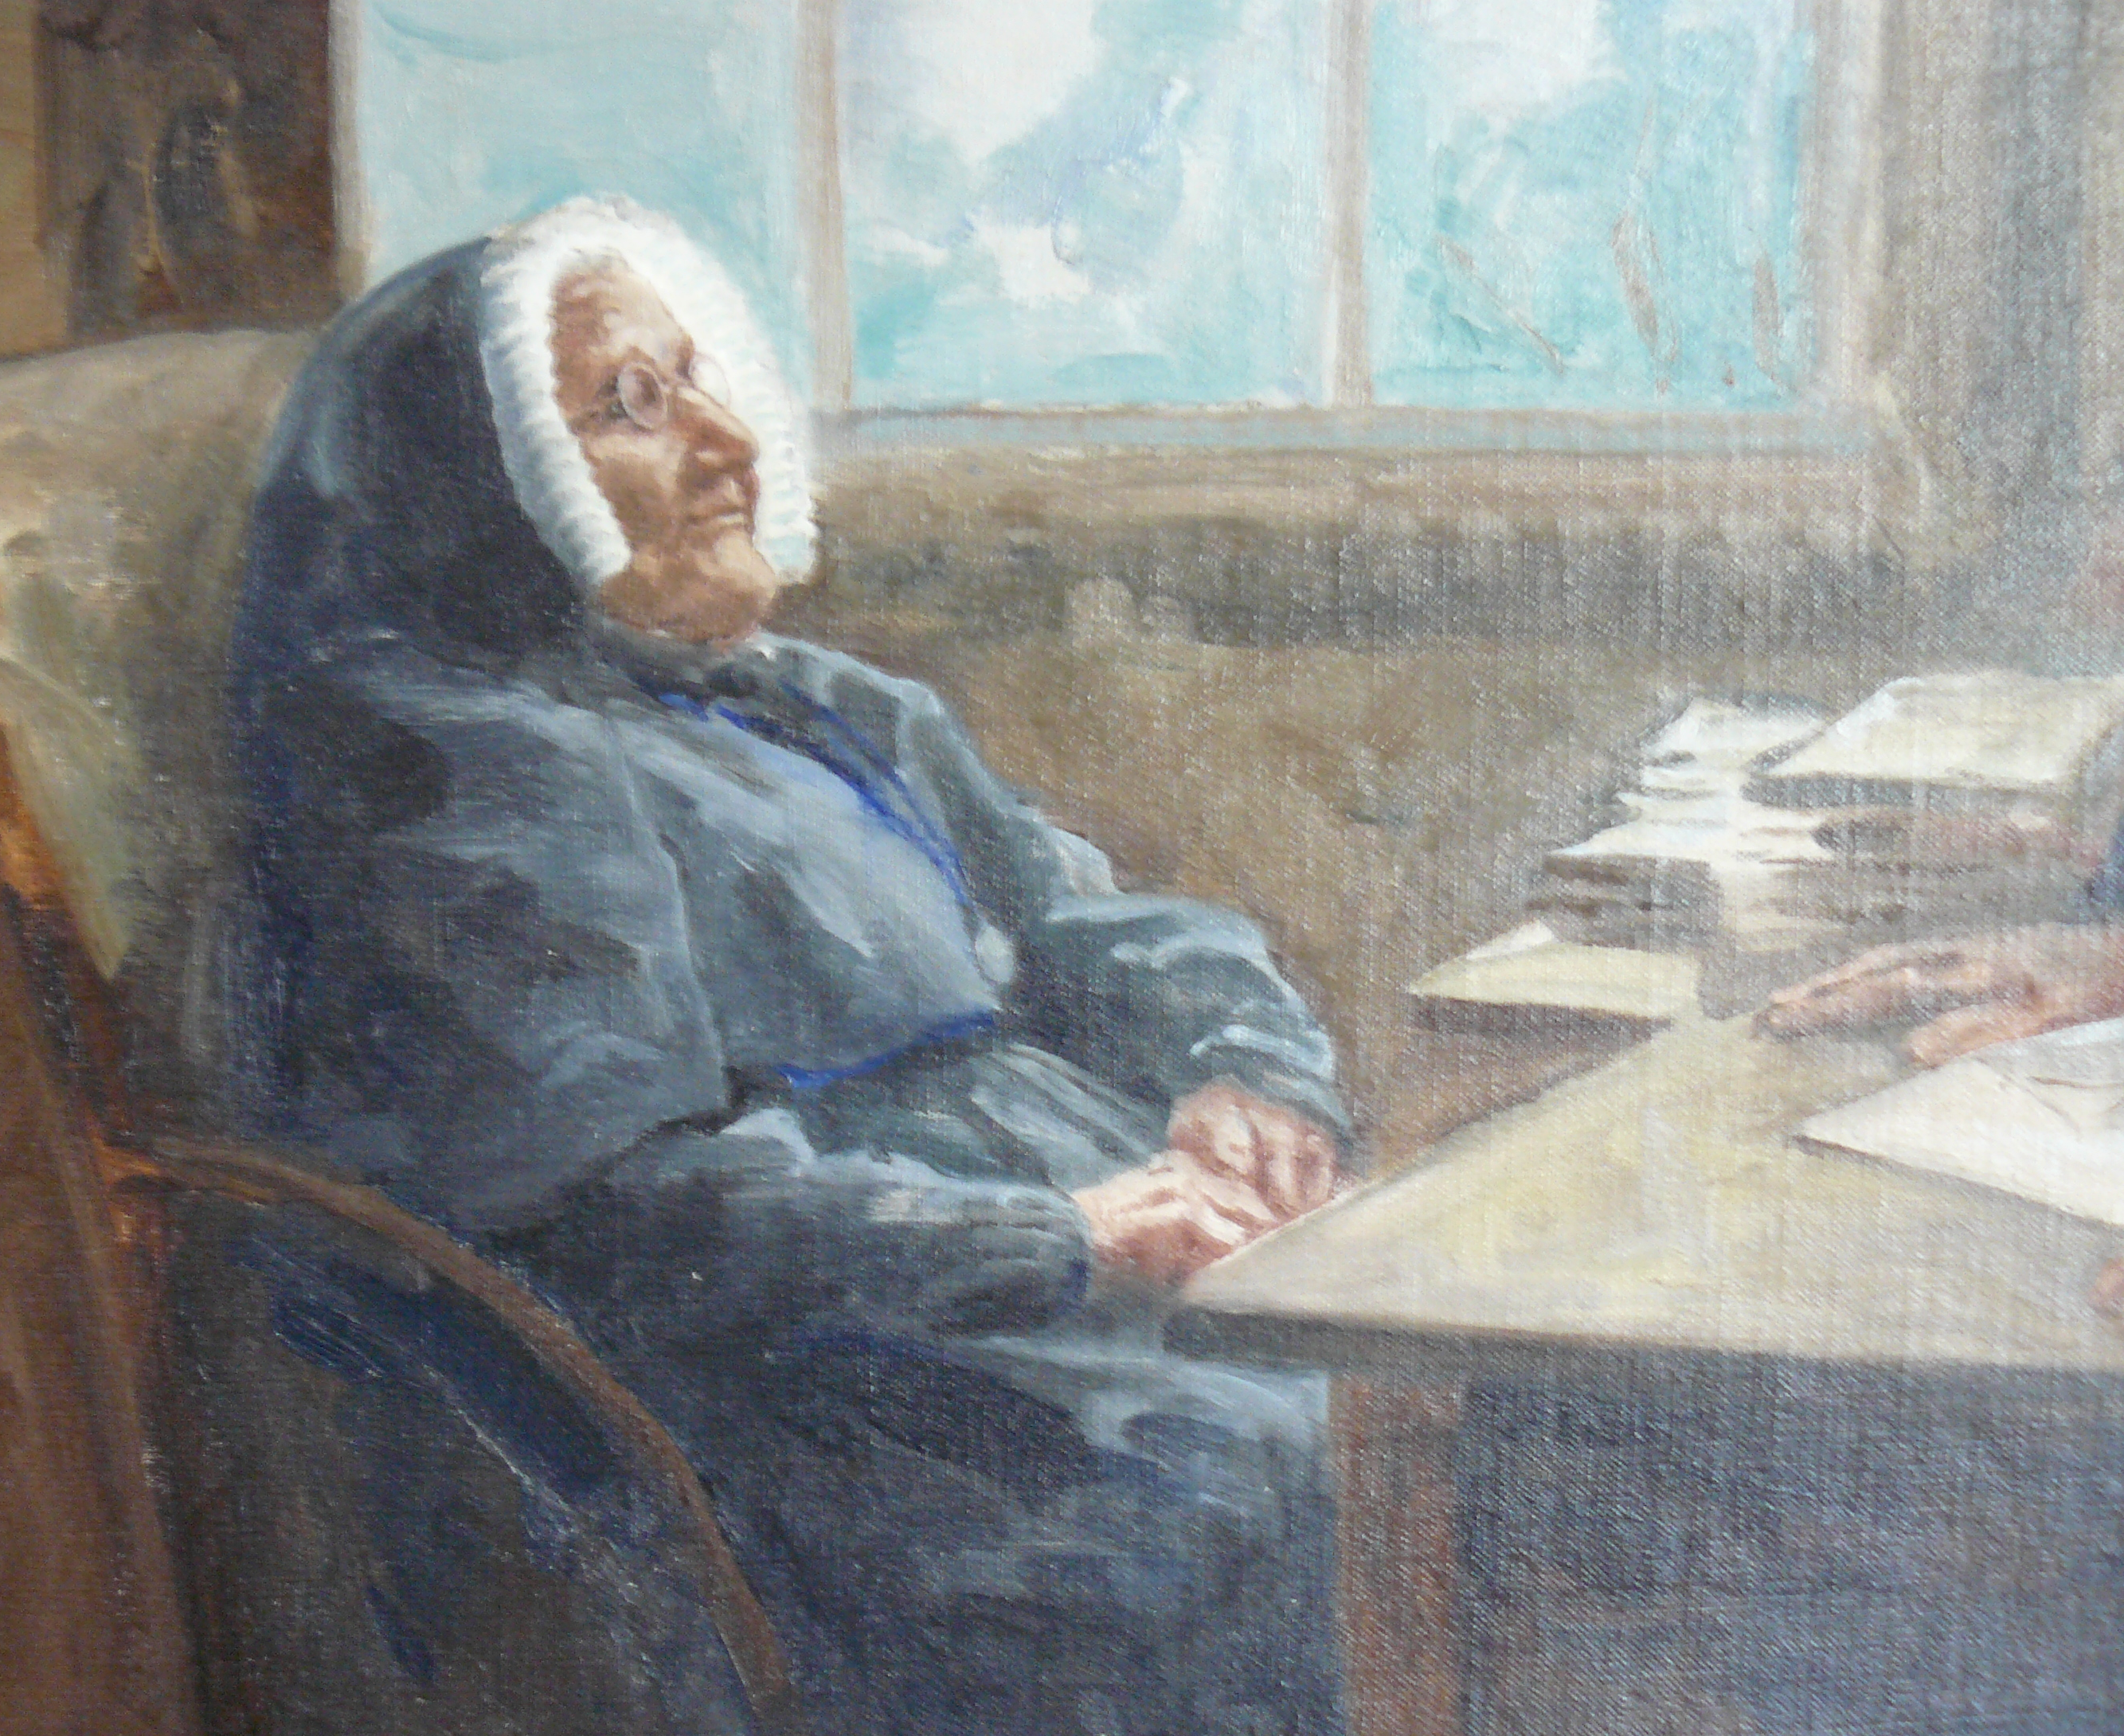
PRAYER FOR THE BEATIFICATION OF MERI HŌHEPA SUZANNE AUBERT
Lord Jesus Christ,
You taught us that as often as we show compassion to the least of our brothers and sisters, we show it to you.
Hear our prayer that Venerable Meri Hōhepa Suzanne Aubert, who came to Aotearoa New Zealand to be with Māori, and dedicated her life to caring for those in poverty and in need, may soon be recognised by the Church as a saint.
Amen.

Slide 2
HE ĪNOI MŌ TE HĀTOTANGA O MERI HŌHEPA
E te Ariki e Hēhu Karaiti,
Nāu mātou i whakaako mēnā ka puaki atu mātou i te pūaroha mō te iti, arā, ngā tēina, ngā tuākana, ngā tuāhine me ngā tungāne, kātahi ka whakaatu mātou i te pūaroha ki ā koe.
Whakarongo mai ki ā mātou īnoi mō Te Kahurangi nei a Meri Hōhepa, i haere mai ia ki Aotearoa, ki te iwi Māori, ā, i whakatapua tōna oranga ki te hunga rawakore me te hunga whai oranga, nā kia whakamanatia ia e te Hāhi hei hāto.
Āmene.

